Slide 1
CM0672 – Artificial intelligence case project
Sufyan Ahmed
Neil Davies
David Birtch
Matt Foggon
Calum Ferguson

Slide 2
Aims & objectives
Create System Design / Requirements plans
Create an Intelligent System using Artificial Intelligence algorithms to play a successful game of checkers
Provide an attractive user interface in which the game will take place
Discuss the Legal, Ethical, Social & Professional Issues of the project
Project Evaluation

Slide 3
Available AI MEthods
NegaMax
Negamax search is a variant form of minimax search that relies on the zero-sum property of a two-player game.
NegaScout
NegaScout is a directional search algorithm for computing the minimax value of a node in a tree.
Monte Carlo Tree Search
Monte Carlo tree search (MCTS) is a heuristic search algorithm for some kinds of decision processes, most notably those employed in game play.

Slide 4
Selected AI Method
Minimax
Used primarily in decision theory and game theory the MiniMax algorithm is used in order to minimize the possible loss in a worst case scenario.
It was created for two player games in which players alternately make moves and has been known to be extended to games of a higher complexity.
This was a good algorithm for the project as checkers is a two player turn based game and between group members there was a little bit of knowledge from previous work.

Slide 5
Project Plan
An initial project plan was drafted when our final project idea came together, due to the nature of the algorithm we decided a turn based game would work best.
Tasks were delegated out between team members in order to ensure that the project was consistent and worked efficiently.

Slide 6
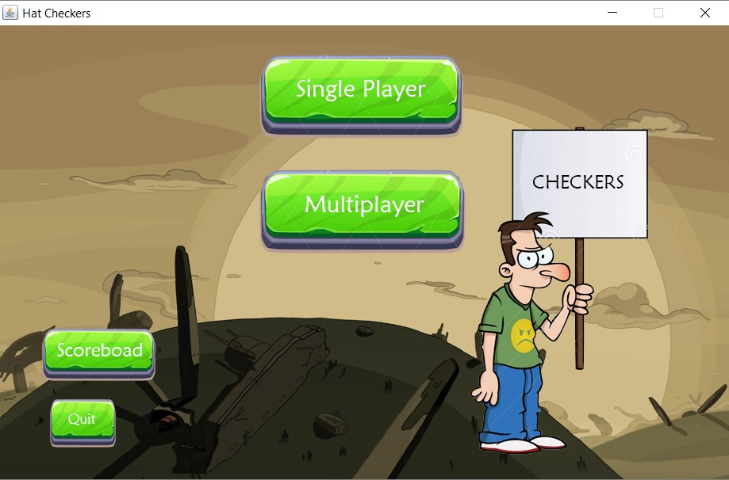
Implementation Process - GUI
Matthew Foggon – Produced and implemented the required code for the mousehandler, the controller (interface) and the frame switcher, that changes the Jpanels to different screens
David Birtch – Produced the GUI user interface and declared the boundaries of the given properties, code also updates board by repainting it

Slide 7
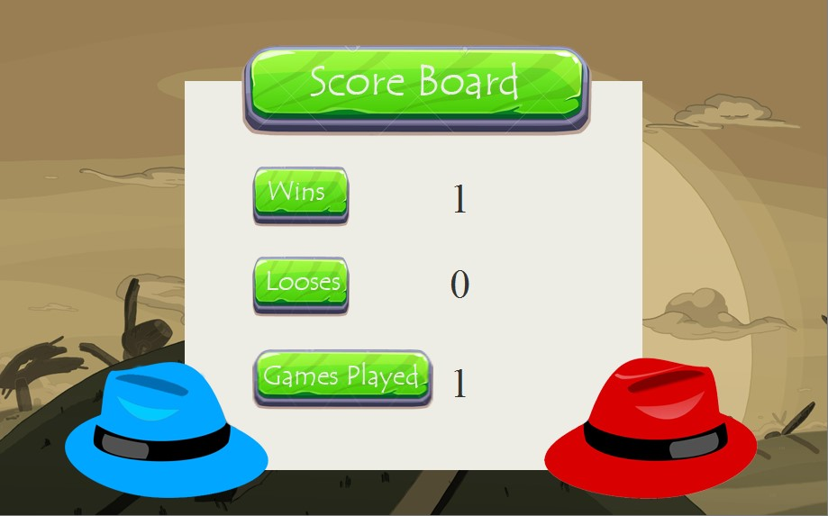
IMPLEMENTATION PROCESS - MINIMAX
Neil Davies – Produced the minimax algorithm, created the AIplayer class code and determines the player move. For the algorithm a score calculation system was also put in pace to evaluate all the best possible moves.

Slide 8
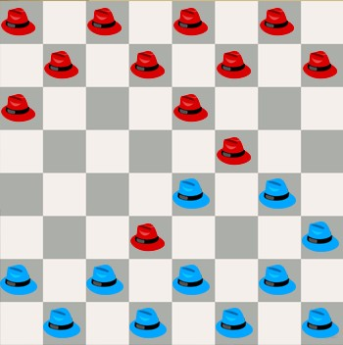
Implementation Process – Board Movement
Sufyan Ahmed – Initialises the board and pieces and declares the information mainly in the pieces location. Produced the code to amend the scores, check game over, move validation. X and y coordinates are also given to determine where the piece is.
Calum Ferguson – Helped with the creation of creating the board rules and code is tested by printing in the console. The Human player class determines if the moves are within the boundaries within the game board

Slide 9
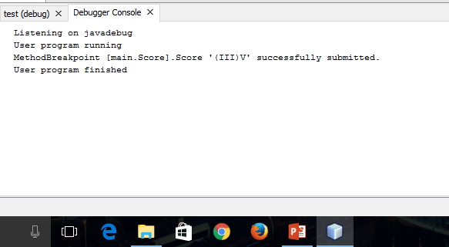
Testing phase
Throughout the project the debugger was used in order to constantly test the code.
By running breakpoints we could test the code line by line in order to ensure that the program was written consistently and there would be no errors in compilation at the end of the project.

Slide 10
Legal, Ethical, Social & Professional Issues of the project
All team members contributed equally to the overall design and implementation of the project
The evaluation of team members are done by peer assessment forms and requires all the team members to attend all group meetings
The product is declared by equal ownership by all members of the team and their work is acknowledged.
If the product ever intends to make a profit, then this profit will have to be split fairly and equally throughout the team

Slide 11
Legal, Ethical, Social & Professional Issues of the project
The images used in this project are nor developed by the team. It was acquired on the internet without the authors permission. These images are not copyright free and cannot be used for commercial purposes such as selling or adverting the product.
Doing so can result in the removal of the product from stores/online and any profit made can be made liable for payments to the original owners of the content. Therefore it is of uttermost important the permission is gained where content has been in the product developed such as images and code.

